Slide 1
Psychometric property and Incremental Validity of the AAQ-II among Chinese Samples
MAAS
Psychological Flexibility
AAQ-II
MLQ
CFQ
Yang Ji & Prof. Zhuo-Hong Zhu
Institute of Psychology
Chinese Academy of Sciences

Slide 2
Thank You for Your Support:
Including sponsorship from the ACBS SPONSERS, and
All the assistances offered by the ACBS TEAM!

Slide 3
Outline
Brief Intro to ACBS at IoP, CAS
Defining Psychological Flexibility (PF)
Valid the AAQ-II in Chinese Samples
Is PF represented by the AAQ-II?
Discussions and Future Prospects

Slide 4
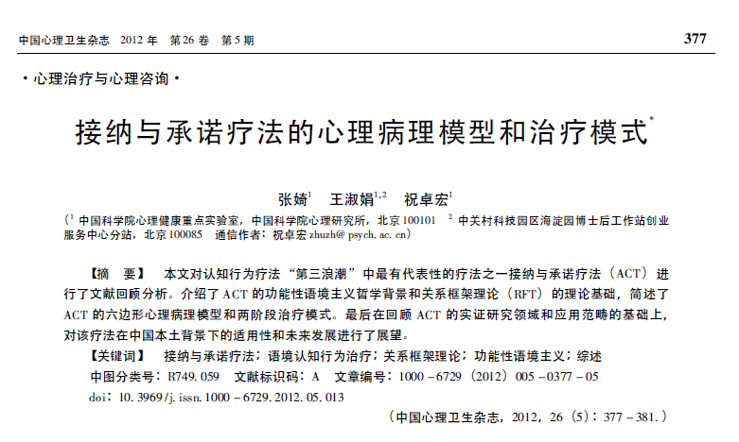
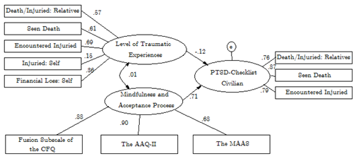
Brief intro to our team
Introducing ACT and RFT to Chinese professionals
Zhang Q, Wang SJ, Zhu ZH. 2012 CMHJ
Wang SJ, Zhang Q, Zhu ZH. 2012 CMHJ
Validation of ACT related Questionnaires
Finalizing Translation of the 2011’ ACT text
Promotion of ACT in Chinese Counselors (Compulsory Content for Registry Examination since 2013)
ACT Mobile Applications

Slide 5
Defining PF
ACT has recently gained popularity and elevated its EBP status
According to Division 12 of the APA (2006), ACT is currently considered as modestly supported for the treatments of depression, mixed anxiety, obsessive-compulsive disorder, psychosis, and strongly supported for the treatment of chronicle pain.
The PF is the defining model for ACT, better understandings of PF and developments of psychometrics in measuring PF will be a key towards the better validation of the ACT therapy.
Has the PF been well-defined, well-measured or perceived as defined? Lo and Behold!

Slide 6
Defining PF: ACBS
The comprehensive definition well appreciated by the ACBS community:
PF = “contacting the present moment fully as a conscious human being, and based on what the situation affords, changing or persisting in behavior in the service of chosen values” (Hayes)
i.e., the Hexaflex (c.f., Hayes, Villatte, Levin, & Hilderbrandt, 2011)

Slide 7
Defining PF: ACBS
Hexaflex
Acceptance: enables the individual to engage the experiences more fully with an attitude of curiosity, to learn from them, and to make room for their occurrence.
Defusion: making closer contact with verbal events as they really are, not merely as what they say they are.
Present Moment Awareness: the voluntary shift of attention that allows one to come into second-by-second contact with life.
Self-As-Context: a kind of coming togther of the major classes of deictic relations, such as I/you, here/there, and now/then.
Value: constructed by interconnected networks of schemas that is process-focused and intrinsic, which can be assessed in more specific life domains
Committed Action: a value based action designed to create a pattern of action that is itself value-based.

Slide 8
BUT…
Have you heard of what others might have gossiped?

Slide 9
defining PF: Other tenants
“If it is a third wave, it is not a tsunami…” (2008) Robert L. Leahy
American Institute for Cognitive Therapy
ACT ∈ CBT
nothing new
Please hold on…

Slide 10
Defining PF: Other tenants
“In addition to altering cognition, many of the strategies advanced by cognitive theory work to achieve distance from and perspective about one’s predicament” (2011)
D.J.A. Dozois & A.T. Beck
ACT ∈ CBT
an advancement of CBT

Slide 11
?
?
?
?
?

Slide 12
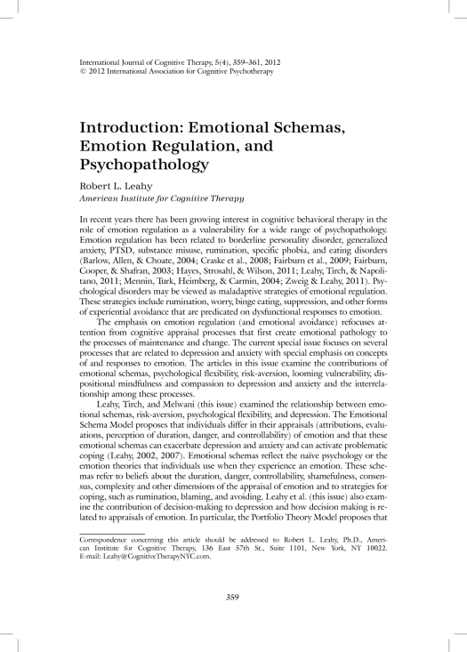
Defining PF: Other tenants
a emotional schema construct
Vol. 5, Iss. 4, Special Section: Emotional Schemas, Emotion Regulation, and Psychopathology
International Journal of Cognitive Therapy

Slide 13
How Do you make of this?
PAPER NO.1:
Processes Underlying Depression: Risk Aversion, Emotional Schema, and Psychological Flexibility
425 psychotherapy patients
“Multiple regression analyses indicated that depression was best predicted by Risk Aversion and Psychological Flexibility. These findings are discussed in terms of the relative contributions of beliefs about emotional experience and risk tolerance as underlying processes affecting psychological flexibility and depression. ”

Slide 14
How Do you make of this?
PAPER NO.2:
Emotional Schemas, Psychological Flexibility, and Anxiety: The Role of Flexible Response Patterns to Anxious Arousal
295 outpatients presenting for CBT
“In regression models, emotional schemas regarding control of affect were the primary predictor of elevated BAI scores while psychological flexibility was the primary predictor of elevated anxiety scores on the MCMI-III”
BAI: Beck Anxiety Inventory
MCMI-III: Millon Clinical Multiaxial Inventory

Slide 15
How Do you make of this?
PAPER NO.3:
Mindfulness, Psychological Flexibility, and Emotional Schemas
107 adult cognitive-behavioral outpatient
“Individuals with higher levels of dispositional mindfulness also had higher levels of psychological flexibility and were more likely to endorse more adaptive dimensions of emotional schemas. Those individual who appeared less psychologically flexible or displayed lower levels of dispositional mindfulness were more likely to report less adaptive and more rigid responses to emotional experiences”

Slide 16
How Do you make of this?
Assumption that the AAQ-II ≡ PF
Concluding PF = M = ES based on the significance of multiple regression coefficients
Where is the mentioning of theoretical underpinnings?
Where is the ΔR² ?
？

Slide 17
Loyalty to PF?
PF = “contacting the present moment fully as a conscious human being, and based on what the situation affords, changing or persisting in behavior in the service of chosen values”

Slide 18
Rationale and aim for our study
Rationale: Validating ACT therapy in China first by developing a valid measuring package pertinent to PF
Aim:
1: Validating the AAQ-II in Chinese
2: Test whether the AAQ-II captures fully the elemental constructs proposed by the PF model

Slide 19
Hypothesis
1: good psychometric properties of the Chinese AAQ-II in terms of exploratory, confirmatory factor analyses (EFA/CFA), and differential item functioning (DIF).
2: incremental variance explained by the AAQ-II in comparisons to alternative measures pertinent to the PS model, or relevant psychological constructs.

Slide 20
Translation of the AAQ-II
Avoid method effects (Bond et al., 2011)
“painful experiences and memories” to “painful experiences” to differ this item from “painful memories” in the other item
Back-translating the 7-item AAQ-II

Slide 21
samples
Sample 1
N = 789
aged between 16 to 26 years (M = 19, SD = 1.64)
freshmen at a University in Beijing
residence ranged from metropolis (N = 409), medium or smaller sized cities (N = 95), towns (N = 114), and villages (N = 171).
Sample 2
N = 238
first year students aged between 17 to 22 years (M = 18.5, SD = .80) from a different department at the same University as Sample 1
194 were retested one month after
residence of this sample of students ranged from cities (60.7%), towns (26.5%) or villages (12.8%).

Slide 22
samples
Sample 3
N = 220, aged between 20 to 76 years (M = 38.4, SD = 10.8)
Employees from a Beijing Based company
Education levels were tertiary (61.4%), diploma (14.1%), or secondary
Sample 4
N = 350 males
officers served more than four years from a military academy base in Beijing
age ranged between 19 to 26 years (M = 22.7, SD = 1.3)
Sample 5
N = 1662, males (1060),
Students at a technical college in regional Sichuan.
Age ranged between 14 to 28 years (M = 16.49, SD = 3.78)
During the Wenchuan Earthquake 364, 858, 362, 78 students respectively were located at extremely-hit, severely stricken, quake-hit, or unaffected areas in Sichuan according to the official criteria (CNCIDR & MOST; 2008).

Slide 23
Materials
Psychological Flexibility Processes
Value
Presence of Meaning Subscale of the Meaning of Life Questionnaire (Steger, 2012)
Broader measure of “chosen value” according to RFT framing
Cognitive Fusion
Cognitive Fusion Questionnaire (Dempster et al., in press)
Present Moment Awareness
Mindful Attention Awareness Scale (Brown & Ryan, 2003)
Relevant Construct
Rumination
Ruminative Response Style Questionnaire(Nolen-Hokesema, 1984)
Unavailable Measures
Self-As-Context
Committed Actions

Slide 24
Statistical analyses
1: Validation
Principal Component Analysis (Sample 1)
Confirmatory Factor Analysis (Sample 2-5)
Differential Item Function based on
General Response Theory (GRM)
Logistic Regression
Sample 2 - 4
2: Incremental Validity (Sample 1-5)
Hierarchical Linear Model (HLM)

Slide 25
Results: EFA & CFA

Slide 26
Results: EFA & CFA

Slide 27
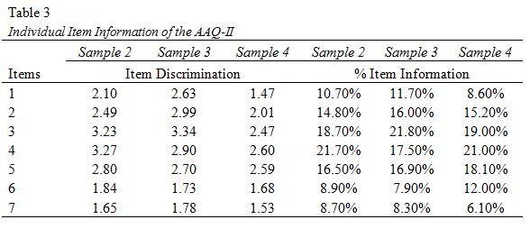
Results: DIF
General Response Theory
Descriptive statistics on Item Discrimination and Information

Slide 28
Results: DIF
Ui was denoted as a discrete random variable representing the ordered item response to item i, and
ui = 0, 1, …, mi – 1 denote the actual response to item i with mi ordered response categories, where
P(ui ≥ k) denotes the cumulative properties that the actual item response ui falls in category k or higher.
The DIF effect is attained by comparing Model 1 with Model 2 for group effects (i.e., uniform DIF), or
with Model 3 for group effects and group item interaction effects (i.e., non-uniform DIF).

Slide 29
Results: DIF

Slide 30
Results: DIF

Slide 31
Results: correlation

Slide 32
Results: correlation

Slide 33
Results: HLM

Slide 34
Results: hlm

Slide 35
Did you notice what was missing from the slides?

Slide 36
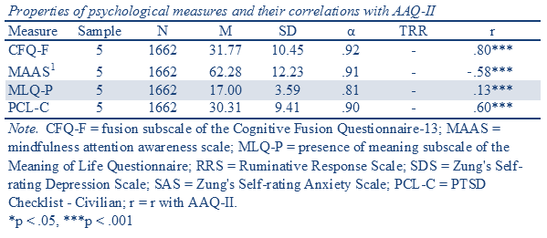
Sample 5 results: weird? Wrong?
Another study utilizing behavioral paradigm suggested that high levels of presence of meaning in individuals high in stress may be associated with low levels of psychological flexibility. It could be that the presence of meaning can become fusion at specific instances – this however will not elaborated here.

Slide 37
Conclusions
The Chinese AAQ-II obtained sound factor structure and model fit.
There are items that were subject to different item functioning among age, gender and groups, nonetheless, the DIF items were not effecting the total scores of the AAQ-II;
The AAQ-II correlates highly with construct pertinent to the PS model, as well as levels of various psychological symptoms and life satisfactions;
The AAQ-II demonstrated incremental validities in comparisons to most alternative measures, however, it did not show incremental validity to cognitive fusion, presence of meaning, and when it was used to predict life satisfaction at times;
The AAQ-II remained a primary predictor for levels of depression and anxiety in multiple regression models including PF related measures, except in the employee sample, when fusion and presence of meaning become more important;
The AAQ-II fail to be the primary predictor for life satisfaction;
In individual exposed to traumatic events (earthquake), the AAQ-II was positively correlated with presence of meaning, which was not expected by the PF model.

Slide 38
Implications and limitations
Implications
A Comprehensive battery for measuring PF according to the hexaflex requires further development;
Value measured by the MLQ-P may not be explaining the original definition of the construct. Value that is cognitive, intrinsic, and domain specific may represent the specific state after the Self-As-Context trainings;
Limitations
Measures for constructs such as the Self-As-Context and the Committed Action was not assessed in our study;
Clinical sample were yet to be tested for the PF model in terms of psychopathology;
Social and demographical factors associated with the contextual stress levels of Chinese individuals may bias questionnaire based results, which may be supported by computerized behavioral tests.

Slide 39
Future prospect
MAAS
Psychological Flexibility
The Chinese AAQ-II retained sound psychometric properties and can be used for the assessment of levels of PS in future interventional studies, especially, the effectiveness of mobile applications utilizing the framework of ACT therapy.
AAQ-II
MLQ
CFQ

Slide 40
Thank You for listening

